Slide 1




Application Workshop Presentation

Slide 2
ANNOUNCEMENT
In place of an in-person workshop, the City of Pasadena’s Community Development Department has made available for download this narrative Application Workshop PowerPoint Presentation. All applicants are strongly encouraged to review this presentation to assist in the application process.
The Community Development Department staff will be available virtually, via a Zoom Q&A to answer questions relating to this PowerPoint and application process. Please refer to the posted Public Notice located at the following link for more information on the date/time/login information for the Zoom Q&A Meeting: https://www.pasadenatx.gov/622/Plans-Notices.
Any questions or concerns may be sent via email to: CommDev@pasadenatx.gov. If you do not have internet access, please contact us at (713) 475-7294 during business hours.
Monday - Thursday: 9:00 am to 4:00 pm
Friday: 9:00 am to 12:00 pm
(closed from 12:00 pm to 1:00 pm daily)

Slide 3
Application Workshop Overview
Community Development Department Staff Information
Funding Updates
Conflicts of Interest
Overview of HUD Programs
Application Schedule of Deadlines
Application Requirements
Evaluation Criteria

Slide 4

Community Development Staff
Sara Rogers, Director of Housing & Community Development
Kayla Coberley, Community Development Manager
Julia Zamarripa, Programs Accountant
Stacey Rodriguez, Programs Coordinator
Kristine Singleton, Programs Coordinator

Slide 5

FUNDING UPDATES
NOTICE: While THE CITY OF PASADENA anticipates receiving similar levels of funding annually, the estimates REFERENCED WITHIN THIS PRESENTATION WILL vary based on allocations from the U.S. Department of Housing and Urban Development (HUD).

Slide 6
Funding Updates
The Community Development Department (CDD) on behalf of the City of Pasadena (City) invites qualified organizations with an eligible project to apply for Community Development Block Grant (CDBG) Program, Emergency Solutions Grants (ESG) Program and/or HOME Investment Partnerships (HOME) Program funding.
CDD seeks organizations that can demonstrate the capacity to assist in meeting the City’s priority needs outlined in the most recently developed Consolidated Plan (https://www.pasadenatx.gov/622/Plans-Notices).
Limitations of the Application for Funding
CDD reserves the right to accept or reject any and all applications received. In addition, CDD reserves the right to negotiate with all qualifying organizations or to cancel in whole or in part, an application if deemed in the best interest of the City as it relates to the Consolidated Plan. Organizations may participate in negotiations and resubmit any proposed expenses, technicalities or other revisions of their application as requested by CDD.

Slide 7
FUNDING AMOUNTS
$1,630,927 CDBG
$326,185
Administration
(20% Cap)
$244,639
Maximum Amount for Public Service Activities
(15% Cap)
$518,697
HOME
$51,870
Administration
(10% Cap)
$148,298
ESG
$11,122
Administration
(7.5% Cap)
$1,060,103
Other CDBG Activities
$389,022
Other HOME Activities
$48,197
Other ESG Activities
$77,805
CHDO Set Aside
(15% Cap)
$88,979
Maximum Amount for Emergency Shelter/Street Outreach Activities (60%)
DISCLAIMER:
The City has not been awarded funding and due to the current uncertainties regarding future federal budgets and funding allocations from HUD, CDD cannot guarantee that funding for CDBG, ESG or HOME programs will be available in the upcoming program year.
NOTICE:
CDBG Public Service and ESG Shelter/Street Outreach Activities will be increased or decreased based on the actual amounts allocated from HUD in accordance with the funding limits associated with each grant.
NOTE:
CDD reserves the right to reallocate funding between projects that best address community needs as reflected in the 2023-2027 Consolidated Plan.
DISCLAIMER: Amounts listed are approximations only.

Slide 8
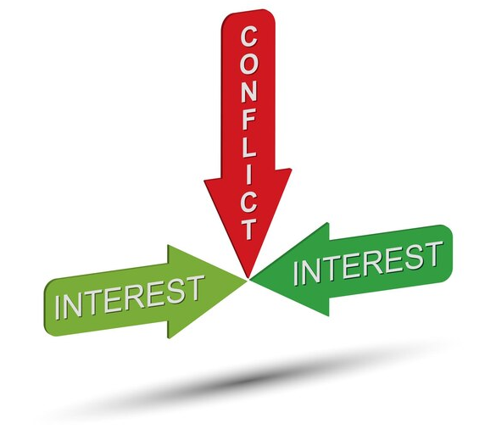
CONFLICTS OF INTEREST
NOTICE: FAILURE TO DISCLOSE ANY PERCEIVED OR ACTUAL CONFLICTS OF INTEREST MAY RESULT IN APPLICATION BECOMING VOID OR TERMINATION OF YOUR GRANT AGREEMENT.

Slide 9
CONFLICTS OF INTEREST
Conflicts of interest (COI) arise when officials or staff stand to benefit, either directly themselves or indirectly through business partners or relatives, from the awarding or contracting of grant funds.
Common Examples Include:
Elected officials voting on awarding of funds to an organization where the elected official and/or a family member is on the staff or on the applicant’s board or directors;
Grantee officials or staff who have relatives who may benefit from an applicant’s programmatic activities; and/or
Failure to notify HUD regarding conflicts of interest, or late/incomplete requests for exceptions.

Slide 10
CONFLICTS OF INTEREST
If a potential conflict arises between the submission of the initial disclosure within the applicant’s application through September 30th, the nature of the conflict should be disclosed in writing to CDD within 15 days including:
The person’s name, position, phone number and address;
Details of the nature of the conflict of interest;
Date of notification; and
Requested action* to address the conflict.
Recusal or Exemption Request (conflict is not resolved until either of these occur)
Additional Resources: https://www.hudexchange.info/resource/5065/hud-integrity-bulletins/

Slide 11
REQUESTING AN EXCEPTION
LEGAL
An opinion by the City’s Legal Department must be obtained
PUBLIC
A public disclosure of the conflict is published
HUD
A written request will be submitted to HUD
Once the Community Development Department is made aware of the potential conflict, the following steps will be taken to request and exception.
NOTICE: HUD determines whether the circumstances fall within the exception
criteria permitted by the regulations. The City may only proceed upon receiving approval in writing from HUD.

Slide 12

OVERVIEW OF PROGRAMS
CDBG
ESG
HOME
DISCLAIMER: The City has not been awarded funding and due to the current uncertainties regarding future federal budgets and funding allocations from HUD, CDD cannot guarantee that funding for CDBG, ESG or HOME programs will be available in the upcoming program year.

Slide 13

COMMUNITY DEVELOPMENT BLOCK GRANT (CDBG)
CDBG
CDBG information contact:
Kristine Singleton
(713) 475-7051
ksingleton@pasadenatx.gov
The primary objective of the CDBG Program is to provide decent housing, a suitable living environment and expanding economic opportunities to local communities. The two ways to achieve this are by choosing the right eligible activity & ensuring that those activities meet a National Objective.

Slide 14
CDBG ELIGIBLE ACTIVITIES
Types of CDBG Eligible Activities
Acquisition and Disposition of Real Property
Housing Activities
Public Facilities and Improvements*
Special Economic Development
Planning
Administration
Public Services*
Micro-Enterprise Assistance
A full list of eligible activities can be found at the following link: https://www.ecfr.gov/current/title-24/part-570#subpart-C
*Most commonly used activities to be discussed further within this presentation.
For information on applying for other activities listed or found on the link provided, please contact our office directly.

Slide 15
CDBG – ELIGIBLE ACTIVITIES PUBLIC FACILITIES AND IMPROVEMENTS
Acquisition, construction, reconstruction, rehabilitation or installation of public improvements or facilities.
Types of Facilities and Improvements
Infrastructure Improvements – water/sewer lines; sidewalks; street improvements
Neighborhood Facilities* – libraries; parks; community centers
Facilities* for persons with special needs – homeless; disabled; seniors
Additional Regulations/Requirements:
The Davis Bacon Act
Environmental Review
The Copeland Anti-Kickback Act
The Contract Work Hours and Safety Standards Act
Section 3
Procurement Process
Bonding
Build America Buy America Act
*Note: If the assisted neighborhood facility is owned by a nonprofit, federal regulations stipulate the facility must be open to the public during normal working hours.

Slide 16
CDBG – ELIGIBLE ACTIVITIES PUBLIC SERVICES
Expenses including, labor, supplies, and material for a public service as well as to operate and/or maintain the portion of a facility in which the public service is located.
To qualify as a Public Service, the service must be either:
A new service; or
A quantifiable increase in the level of an existing service which has been provided by the state or another entity on its behalf through state or local government funds in the 12 months preceding the submission of the Consolidated Plan and/or Annual Action Plan.
This provision is in place to ensure localities did not use CDBG funds to replace local or state monies to fund essential services typically offered by the local government entity.
Types of Public Services:
Employment Services
Child Care Services
Health Services
Education Programs
Senior Services
Homeless Services
Substance Abuse Services
Fair Housing Counseling
Food Bank Services
*Note: Public Service Activity Funds are limited due to federal spending caps.

Slide 17
CDBG – INELIGIBLE ACTIVITIES
Assistance for buildings used for the general conduct of government
Local government expenses
Political activities
New housing construction
Income payments
Purchase of equipment
Activities not primarily benefiting lower income resident households

Slide 18
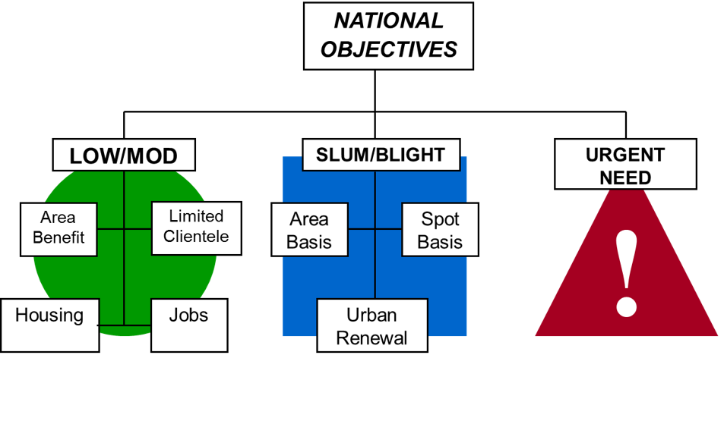
CDBG NATIONAL OBJECTIVES
The authorizing statue of the CDBG program requires that each activity funded meet one of three National Objectives.
The three National Objectives for CDBG funded activities are:
Benefit Low-to Moderate Income Persons* (LMI)
Prevention or Elimination of Slums or Blight
Urgent Need
*The following slides will review the most used National Objective (LMI) and it’s subcategories.
For questions regarding a National Objective not listed within this presentation, please contact our office directly or refer to link provided.
Additional information on CDBG National Objectives can be found at the following link: https://www.ecfr.gov/current/title-24/part-570#570.208

Slide 19
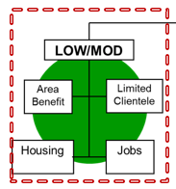
CDBG – LMI NATIONAL OBJECTIVE
The LMI national objective is often referred to as the “primary” national objective because the statute requires that the City expend 70 percent of CDBG funds to benefit LMI persons.
The following slides will cover two of the four categories that can be used to meet the LMI national objective:
Area benefit activities
Limited clientele activities
Housing activities
Job creation or retention activities

Slide 20

LOW MOD AREA BENEFIT (LMA)
Two-Step Documentation Process
Determine the Service Area
Applicants must determine the service area of the activity before CDBG assistance can be provided. Considerations for drawing a service area:
The nature of the activity
The location of the activity
The accessibility of the activity
Comparable facilities/services in the area
Area must be REASONABLY DELINEATED given the type of activity – is the area delineated capturing the people that will actually benefit from the activity?
Area does not have to use same boundaries as census
Do not want to see services areas to benefit upper income areas but drawn in a way that shows that they benefit low income areas when they really don’t
Document the Percentage of LMI Persons
Low Moderate Income Summary Data (LMISD) – HUD provides data based on the most recent American Community Survey (ACS). HUD builds the LMI Area Data file from a special tabulation of Income and Family Size. CPD Notice 24-04 discusses how to use the LMISD geographies to match the service area.
Local Income Survey – Applicant conducts income survey and complies data for submission and review. HUD Notice CPD-14-013 provides guidelines for conducting an income survey for LMA activities. CPD Notice 24-04 provides policy regarding the minimum standards for confidence internal and margin of error for local income surveys.
This category of LMI is the most commonly used national objective for activities that benefit a residential neighborhood.
An area benefit activity is one that benefits all residents in a particular area, where at least 51 percent of the residents are LMI persons.
Demonstrating Area Benefit to Low- and Moderate-Income Persons:
https://www.youtube.com/watch?v=UW4Nqo11iOw

Slide 21
LOW MOD LIMITED CLIENTELE (LMC)
Low Mod Limited Clientele Qualification Requirements
With respect to determining the beneficiaries of activities as LMI and qualifying under the limited clientele category, activities must meet one of the following tests:
Benefit a clientele that is generally presumed to be principally LMI (abused children, battered spouses, severely disabled adults, homeless persons, illiterate adults, persons with AIDS, migrant farm workers and elderly); or
Require documentation on family size and income in order to show that at least 51 percent of the clientele are LMI*; or
Have income eligibility requirements limiting the activity to LMI persons only*; or
Be of such nature and in such a location that it can be concluded that clients are primarily LMI persons.
*Applicant’s who select either options 2 or 3 for qualifying must collect information during client intake and ensure they have policies and procedures in place for collecting and securing documentation.
The LMC category is a second way to qualify specific activities under the LMI benefit national objective. Under this category, 51 percent of the beneficiaries of an activity have to be LMI persons.
In contrast to LMA, it is not the LMI concentration of the service area of the activity that determines whether the activity will qualify or not, but rather the actual number of LMI persons that benefit from the activity.
Activities that require information on family size and income must use “Eligible Income by Family Size” chart posted at the following link to determine if applicants qualify under the current low and moderate income limits:
https://www.pasadenatx.gov/280/Subrecipient-Organization-Information
*NOTE: Income limits are updated annually and posted on the City’s website once released by HUD.

Slide 22
CDBG ADDITIONAL RESOURCES
The links listed on this slide are resource tools for those seeking additional information regarding CDBG regulations, requirements and overall program management.
Income Eligibility Calculator https://www.hudexchange.info/incomecalculator/
Basically CDBG Guidebook https://www.hudexchange.info/resource/19/basically-cdbg-training-guidebook-and-slides/
HUD CDBG Income Limits https://www.hudexchange.info/resource/5334/cdbg-income-limits/
Playing by the Rules Handbook https://www.pasadenatx.gov/DocumentCenter/View/6173/
Playing-by-the-Rules-Handbook-PDF
CDBG in 3 Minutes Video https://www.youtube.com/watch?v=AvQe6YzbCXk

Slide 23

EMERGENCY SOLUTIONS GRANTS (ESG)
ESG
ESG information contact:
Kristine Singleton
(713) 475-7051
ksingleton@pasadenatx.gov
The ESG program provides funding to: (1) engage homeless individuals and families living on the streets; (2) improve the number and quality of emergency shelters for homeless individuals and families; (3) help operate these shelters; (4) provide essential services to shelter residents; (5) rapidly re-house homeless individuals and families, and (6) prevent families/individuals from becoming homeless.

Slide 24
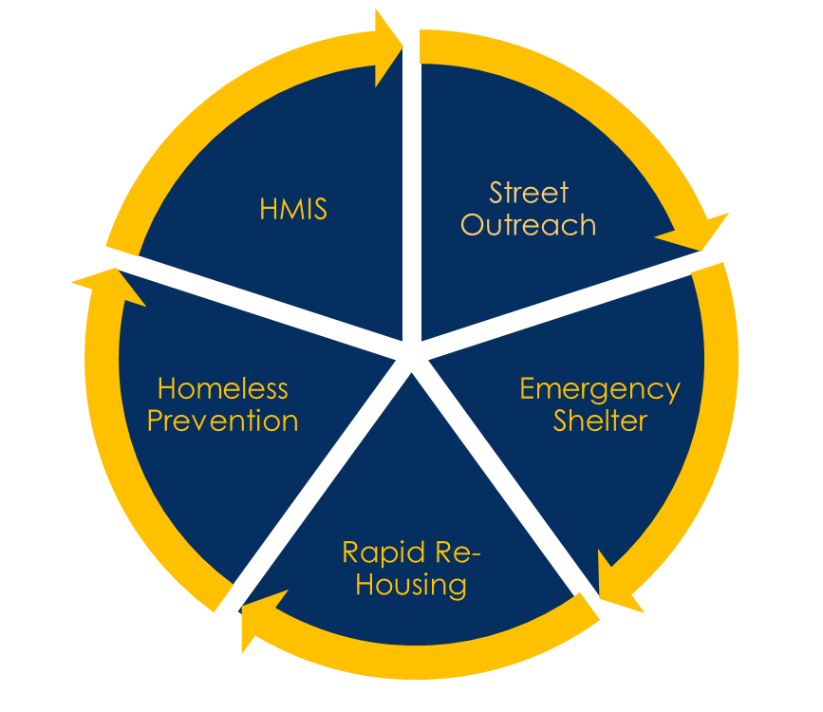
ESG PROGRAM COMPONENTS
The goal of the ESG Program is to assist individuals and families EXPERIENCING HOMELESSNESS or who are AT-RISK OF HOMELESSNESS in obtaining and maintaining appropriate permanent housing through utilizing one of the following five components:
There are five program components under ESG, each with their own set of eligible activities and costs:
Street Outreach
Emergency Shelter
Rapid Re-Housing
Homeless Prevention
Homeless Management Information System (HMIS)
For questions regarding a program component not listed within this presentation, please contact our office directly or refer to link provided.
Additional Resource: https://www.hudexchange.info/trainings/courses/esg-program-components-and-activities-webinar1/

Slide 25
STREET OUTREACH
COMPONENT DESCRIPTION: Activities under this component are designed to meet the immediate needs of unsheltered homeless people by connecting them with emergency shelter, housing, and/or critical health services. (24 CFR 576.101)
Activity Type: | Essential Services
Eligible Costs: | Engagement Case Management Emergency Health Services Emergency Mental Health Services Transportation Services for Special Populations

Slide 26
EMERGENCY SHELTER
COMPONENT DESCRIPTION: Activities under this component are designed to increase the quantity and quality of temporary shelters provided to homeless people, through the renovation of existing shelters or conversion of buildings to shelters, paying for the operating costs of shelters, and providing essential services. (24 CFR 576.102)
ACTIVITY TYPE: | Essential Services | Renovation | Shelter Operations | Assistance with URA
ELIGIBLE COSTS: | Case Management Child Care Education Services Employment Assistance & Job Training Outpatient Health Services Legal Services Life Skills Training Mental Health Services Substance Abuse Treatment Services Transportation Services for Special Populations | Labor Materials Tools Other Costs for Renovation (including rehab or conversion) | Maintenance Rent Security Fuel Equipment Insurance Utilities Food Furnishings Supplies Necessary for Shelter Operations Hotel/Motel Vouchers | Relocation Payments Other Assistance to Displaced Persons

Slide 27
RAPID REHOUSING
COMPONENT DESCRIPTION: Activities under this component are designed to move homeless people quickly to permanent housing through housing relocation and stabilization services and short-and/or medium-term rental assistance. (24 CFR 576.104)
ACTIVITY TYPE: | Rental Assistance | Housing Relocation and Stabilization Services
 |  | Financial Assistance | Services Costs
ELIGIBLE COSTS: | Short-term Rental Assistance Medium-term Rental Assistance Rental Arrears Rental assistance may be project-based or tenant-based. | Rental Application Fees Security Deposits Last Month’s Rent Utility Deposits Utility Payments Moving Costs | Housing Search and Placement Housing Stability Case Management Mediation Legal Services Credit Repair

Slide 28
HOMELESS PREVENTION
COMPONENT DESCRIPTION: Activities under this component are designed to prevent an individual or family from moving into an emergency shelter or living in a public or private place not meant for human habitation through housing relocation and stabilization services and short-and/or medium-term rental assistance. (24 CFR 576.103)
ACTIVITY TYPE: | Rental Assistance | Housing Relocation and Stabilization Services
 |  | Financial Assistance | Services Costs
ELIGIBLE COSTS: | Short-term Rental Assistance Medium-term Rental Assistance Rental Arrears Rental assistance may be project-based or tenant-based. | Rental Application Fees Security Deposits Last Month’s Rent Utility Deposits Utility Payments Moving Costs | Housing Search and Placement Housing Stability Case Management Mediation Legal Services Credit Repair

Slide 29
HMIS
COMPONENT DESCRIPTION: Activities under this component are designed to fund ESG recipients’ and subrecipients’ participation in the HMIS collection and analyses of data on individuals and families who are homeless and at-risk of homelessness. (24 CFR 576.107)
Activity Type: | HMIS
Eligible Costs: | Contributing data to the HMIS designated by the CoC for the area; HMIS Lead (as designated by the CoC) costs for managing the HMIS system; Victim services or legal services provider costs to establish and operate a comparable database.

Slide 30
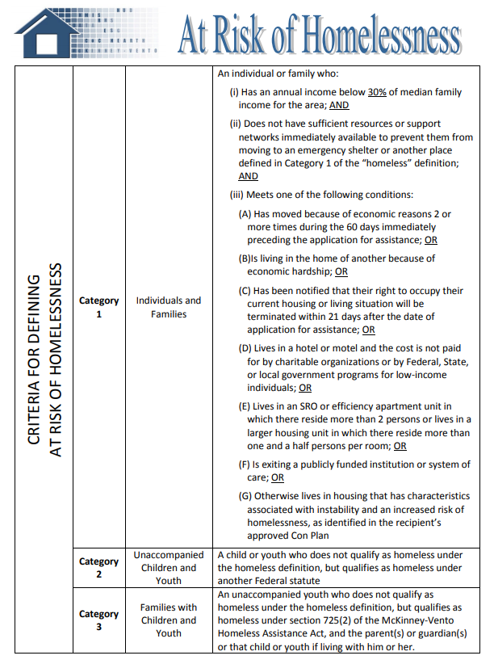
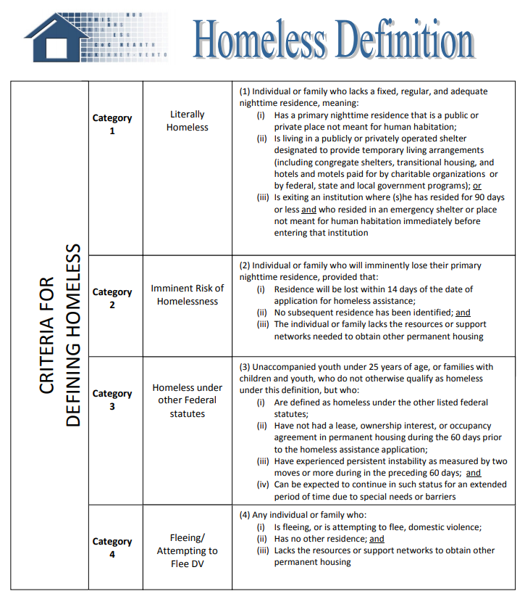

HOMELESS & AT RISK OF HOMELESSNESS DEFINITIONS

Slide 31
MEETING ELIGIBILITY OF DEFINITIONS
RAPID REHOUSING ASSISTANCE: This assistance, referred to as rapid re-housing assistance, may be provided to program participants who meet the criteria under paragraph (1) of the “homeless” definition in §576.2 or who meet the criteria under paragraph (4) of the “homeless” definition and live in an emergency shelter or other place described in paragraph (1) of the “homeless” definition.
HOMELESS PREVENTION ASSISTANCE: This assistance, referred to as homelessness prevention, may be provided to individuals and families who meet the criteria under the “at risk of homelessness” definition, or who meet the criteria in paragraph (2), (3), or (4) of the “homeless” definition in §576.2 and have an annual income below 30 percent of median family income for the area, as determined by HUD.

Slide 32
ESG ADDITIONAL RESOURCES
The links listed on this slide are resource tools for those seeking additional information regarding ESG regulations, requirements and overall program management.
ESG Program Resources https://www.hudexchange.info/programs/esg/guides/#tools-and-guidance
ESG Income Limits - HUD https://www.hudexchange.info/resource/5079/esg-income-limits/
ESG Laws & Regulations https://www.hudexchange.info/programs/esg/esg-law-regulations-and-notices/#laws
ESG Regulations 24 CFR 576 https://www.ecfr.gov/current/title-24/subtitle-B/chapter-V/subchapter-C/part-576

Slide 33

HOME INVESTMENT PARTNERSHIPS PROGRAM (HOME)
HOME
NOTE: AT THIS TIME THE COMMUNITY DEVELOPMENT DEPARTMENT IS ONLY ACCEPTING HOME APPLICATIONS FOR QUALIFIED COMMUNITY HOUSING DEVELOPMENT ORGANIZATIONS (CHDOS). REFER TO SLIDES 35-36 FOR REQUIREMENTS.
HOME information contact:
Stacey Rodriguez
(713) 475-4881
srodriguez@pasadenatx.gov
The program was designed to reinforce several important values and principles of community development. The intent of the HOME Program is to provide decent affordable housing to low-income households within the City of Pasadena through housing rehabilitation, homebuyer assistance, new housing construction and rental housing.

Slide 34
ELIGIBLE USES OF HOME FUNDS
Types of HOME Eligible Activities
Site Acquisition
Site Improvements
Demolition/Reconstruction and/or Rehabilitation
Relocation
Other necessary and reasonable activities related to the development of affordable housing
Activities that require information on family size and income must use “HOME Income Limits” chart posted at the following link to determine if applicants qualify under the current low and moderate income limits: https://www.pasadenatx.gov/280/Subrecipient-Organization-Information
*NOTE: Income limits are updated annually and posted on the City’s website once released by HUD.
All beneficiaries MUST have annual household incomes at or below 80 percent of the area median income, as defined by HUD.
A full list of eligible activities can be found at the following link: https://www.ecfr.gov/current/title-24/subtitle-A/part-92/subpart-E/subject-group-ECFRf448ea7bbdfb69a/section-92.205

Slide 35

COMMUNITY HOUSING DEVELOPMENT ORGANIZATION (CHDO)
A CHDO is a private, nonprofit, community-based service organization with qualified staff that has the capacity to develop affordable housing as the owner, developer, or sponsor for the Pasadena area.

Slide 36
CHDO INFORMATION
CHDO Qualification Requirements
To qualify as a CHDO, a nonprofit must meet the following requirements:
Legal structure and tax status;
Financial management capacity and accountability to low-income community;
Staff capacity to carry out HOME funded activities;
Experience serving the community for at least one year;
Board representation by community members (minimum 1/3 low-income); and
Lack of for-profit or public control.
Eligible CHDO Activities:
Acquisition and/or rehabilitation of rental housing;
New construction of rental housing;
Acquisition and/or rehabilitation of homebuyer properties;
New construction of homebuyer properties; or
Direct financial assistance to purchasers of HOME-assisted housing sponsored or developed by a CHDO with HOME funds.

Slide 37
HOME ADDITIONAL RESOURCES
The links listed on this slide are resource tools for those seeking additional information regarding HOME regulations, requirements and overall program management.
HOME Program Overview https://www.hudexchange.info/programs/home/home-overview/
HOME Income Limits - HUD https://www.hudexchange.info/programs/home/home-income-limits/
HOME Laws & Regulations https://www.hudexchange.info/programs/home/home-laws-and-regulations/
HOME Regulations 24 CFR 92 https://www.ecfr.gov/current/title-24/subtitle-A/part-92#_top

Slide 38

ADDITIONAL INFORMATION
GENERAL RECORDKEEPING AND ADDITIONAL ITEMS TO CONSIDER WHEN APPLYING FOR FEDERAL FUNDS

Slide 39

General Record Keeping Information
Each Subrecipient is required to establish and maintain at least three major categories of records:
1. Administrative records - apply to the overall administration of the federally funded project/program.
General project/program files – application, agreement, program policies and guidelines, correspondence, reports, etc.
Personnel files, property management files.
2. Financial records - including chart of accounts, manual on accounting procedures, journals and ledgers, source documentation, procurement files, bank account records, financial reports, audit files.
3. Project/case files – detailed documentation of the activities undertaken.
*Record Retention: City of Pasadena requires records to be retained for 5 years, plus the current program year, or until the completion of the activity, whichever is longer.

Slide 40

Items to Consider When Applying
Does my agency have the capacity to adhere to all requirements and regulations?
Agency must have a comprehensive policy and procedures manual for program to be administered with federal funds.
How will I determine client eligibility? How will I track clients served?
Proposals including salaries will require a daily time log of 15 minute – hour increments submitted in conjunction with Time & Attendance Sheet Form and paystubs.
Are there additional funding sources being used to leverage federal funds?
Are my agency’s accounting procedures equipped to manage federal funding/reporting requirements?

Slide 41

Application Schedule & Timeline
Wednesday, February 11, 2026 and Wednesday, February 18, 2026
City of Pasadena Community Development Department published Notice
of Funding Availability.
Wednesday, February 11, 2026
Application Workshop PowerPoint and Applications made available online.
Thursday, March 5, 2026 – 10:00 A.M.-11:00 A.M.
Application Workshop Zoom Q&A Meeting.
Monday, March 16, 2026 Application Deadline
Applications must be received by the City Secretary’s office no later than
4:00 P.M.
Monday, April 6, 2026
City of Pasadena Community Development Department Manager prepares funding recommendations and submits to Director of Housing and Community Development.
April 7, 2026 through August 14, 2026
City of Pasadena Community Development Department staff prepares, presents and submits Action Plan to City Council for submission to HUD.
Friday, August 14, 2026
Deadline for City of Pasadena Community Development Department Action Plan submission to HUD.

Slide 42

Application Requirement Information
Late applications will NOT be accepted:
DEADLINE: Monday, March 16, 2026 by 4:00 PM
All applications must be typed!
Must submit two (2) original applications signed by authorized official of your organization (examples include: Department Director, Board of Directors, Grant Administrator, Certifying Official on behalf of organization)
Application Workshop PowerPoint, Applications for Funding and Zoom meeting link information will be available on the City of Pasadena website at the following address: https://www.pasadenatx.gov/280/Subrecipient-Organization-Information

Slide 43

Application Evaluation Criteria
All projects submitted for funding consideration should meet the following threshold criteria to be eligible for a funding commitment:
Contributes to Implementation of Consolidated Plan Goals
The proposed project must match one or more of the City’s funding priorities as listed in the Annual Action Plan, meet a National Objective (as applicable) and provide evidence of need for the project.
Site Control
The applicant should have site control or an opportunity for site control of all properties needed for project completion.
Financial Feasibility
The applicant must submit information to provide evidence of a financially feasible project, evidenced by a complete listing of anticipated funding sources available to the project, anticipated uses of funds, confidence in the availability of funds, evidence of need and any applicable projections that illustrate reasonable assumptions regarding successful implementation.

Slide 44
Application Evaluation Criteria (Cont.)
Project Time Frame
The applicant should submit a timeline for project completion that makes reasonable assumptions concerning land acquisition and site preparation, funding cycles and parameters for all funding sources, and construction and/or service delivery timelines. The applicant’s history in project delivery/completion will also be considered.
Leverage of Other Funds
Leveraging other funds is strongly encouraged. The City may elect to transmit funds to projects later in the process after other funding has been utilized. A financial review shall be conducted on all projects through a thorough examination of the sources and uses of funds and the project budget.
Capacity of Applicant
The applicant should provide information regarding its track record of successful project development, timely completion and projects-in-service or, in the case of a new or emerging subrecipient, evidence of program/project management expertise. The City is interested in investing funds in viable projects that will provide quality services or infrastructure/facilities in an efficient and timely manner.
Readiness to Proceed
Funding consideration will be given to projects that are considered to have best met the overall tests for feasibility, comprehensiveness of planning and timeliness of completion and funding drawdown of federal dollars.

Slide 45

ZOOM Q&A Meeting Information
Community Development staff will be available via Zoom to answer questions regarding the Application Workshop PowerPoint and application process.
Please refer to the posted Public Notice located at the following link for more information on the date/time/login information for the Zoom Q&A Meeting: https://www.pasadenatx.gov/622/Plans-Notices.
Zoom Meetings Login:
https://zoom.us/j/8100210129?pwd=MitpQW9yWUNmOUcwL3crSFluYXR2Zz09
Meeting ID: 810 021 0129
Passcode: 0KHcd8
Participation in the Application Workshop Zoom Q&A Meeting is NOT mandatory.

Slide 46


QUESTIONS
Contact Community Development
Phone (713) 475-7294
Commdev@pasadenatx.gov
Sara Rogers, Director
Phone: (713) 475-4910
Email: SMZavala@pasadenatx.gov
Kayla Coberley, Manager
Phone: (713) 475-4994
Email: KCoberley@pasadenatx.gov
Julia Zamarripa, Programs Accountant
Phone: (713) 475-4902
Email: jzamarripa@pasadenatx.gov
Stacey Rodriguez, Programs Coordinator
Phone: (713) 475-4881
Email: SRodriguez@pasadenatx.gov
Kristine Singleton, Programs Coordinator
Phone: (713) 475-7051
Email: KSingleton@pasadenatx.gov

